Slide 1

Clare Sexton
Bioinformatics Final Presentation

Slide 2

Quick Review
What is a Somatic Mutation?
A somatic mutation occurs from damage to genes in an individual cell during a person’s life.
Not genetically passed from parent to offspring
Somatic mutations can arise from a variety of sources for example → tobacco use, UV and carcinogen exposures, viruses, and aging.

Slide 3
What is COSMIC?
COSMIC ~ the Catalogue of Somatic Mutations in Cancer ~ is the world’s largest source of expert manually curated somatic mutation information relating to human cancers.
Web-based resource.

Slide 4
Uses
If you want to gather more information regarding somatic mutations.
If you want information about relationships between specific mutations and certain cancers.
Can be used to discover novel driver genes for cancer research.
Notes:
Driver Genes: genes that drive the development of cancer

Slide 5
Type of Database
Oracle Relational Database→ stores and provides access to data points that are related to one another.
Can run on across operating systems such as Windows, Unix, Linux, MacOS
The primary site gathers data from expert curation of scientific literature and data from large-scale, genome-wide studies.
Notes:
Bamford, S., Dawson, E., Forbes, S. et al. The COSMIC (Catalogue of Somatic Mutations in Cancer) database and website. Br J Cancer 91, 355–358 (2004). https://doi.org/10.1038/sj.bjc.6601894
https://www.oracle.com/database/what-is-a-relational-database/
A relational database is a type of database that stores and provides access to data points that are related to one another. Relational databases are based on the relational model, an intuitive, straightforward way of representing data in tables. In a relational database, each row in the table is a record with a unique ID called the key. The columns of the table hold attributes of the data, and each record usually has a value for each attribute, making it easy to establish the relationships among data points.

Slide 6
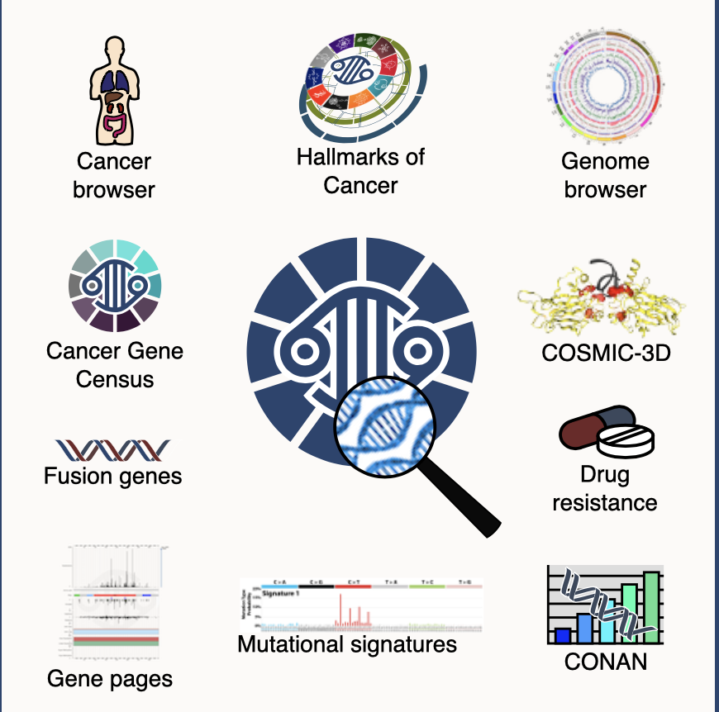
Tools:
Genome Browser
COSMIC-3D
Drug Resistance
CONAN
Mutational Signatures
Gene Pages
Fusion Genes
Cancer Gene Census
Cancer Browser
Hallmarks of Cancer
Notes:
Expert curation

Slide 7
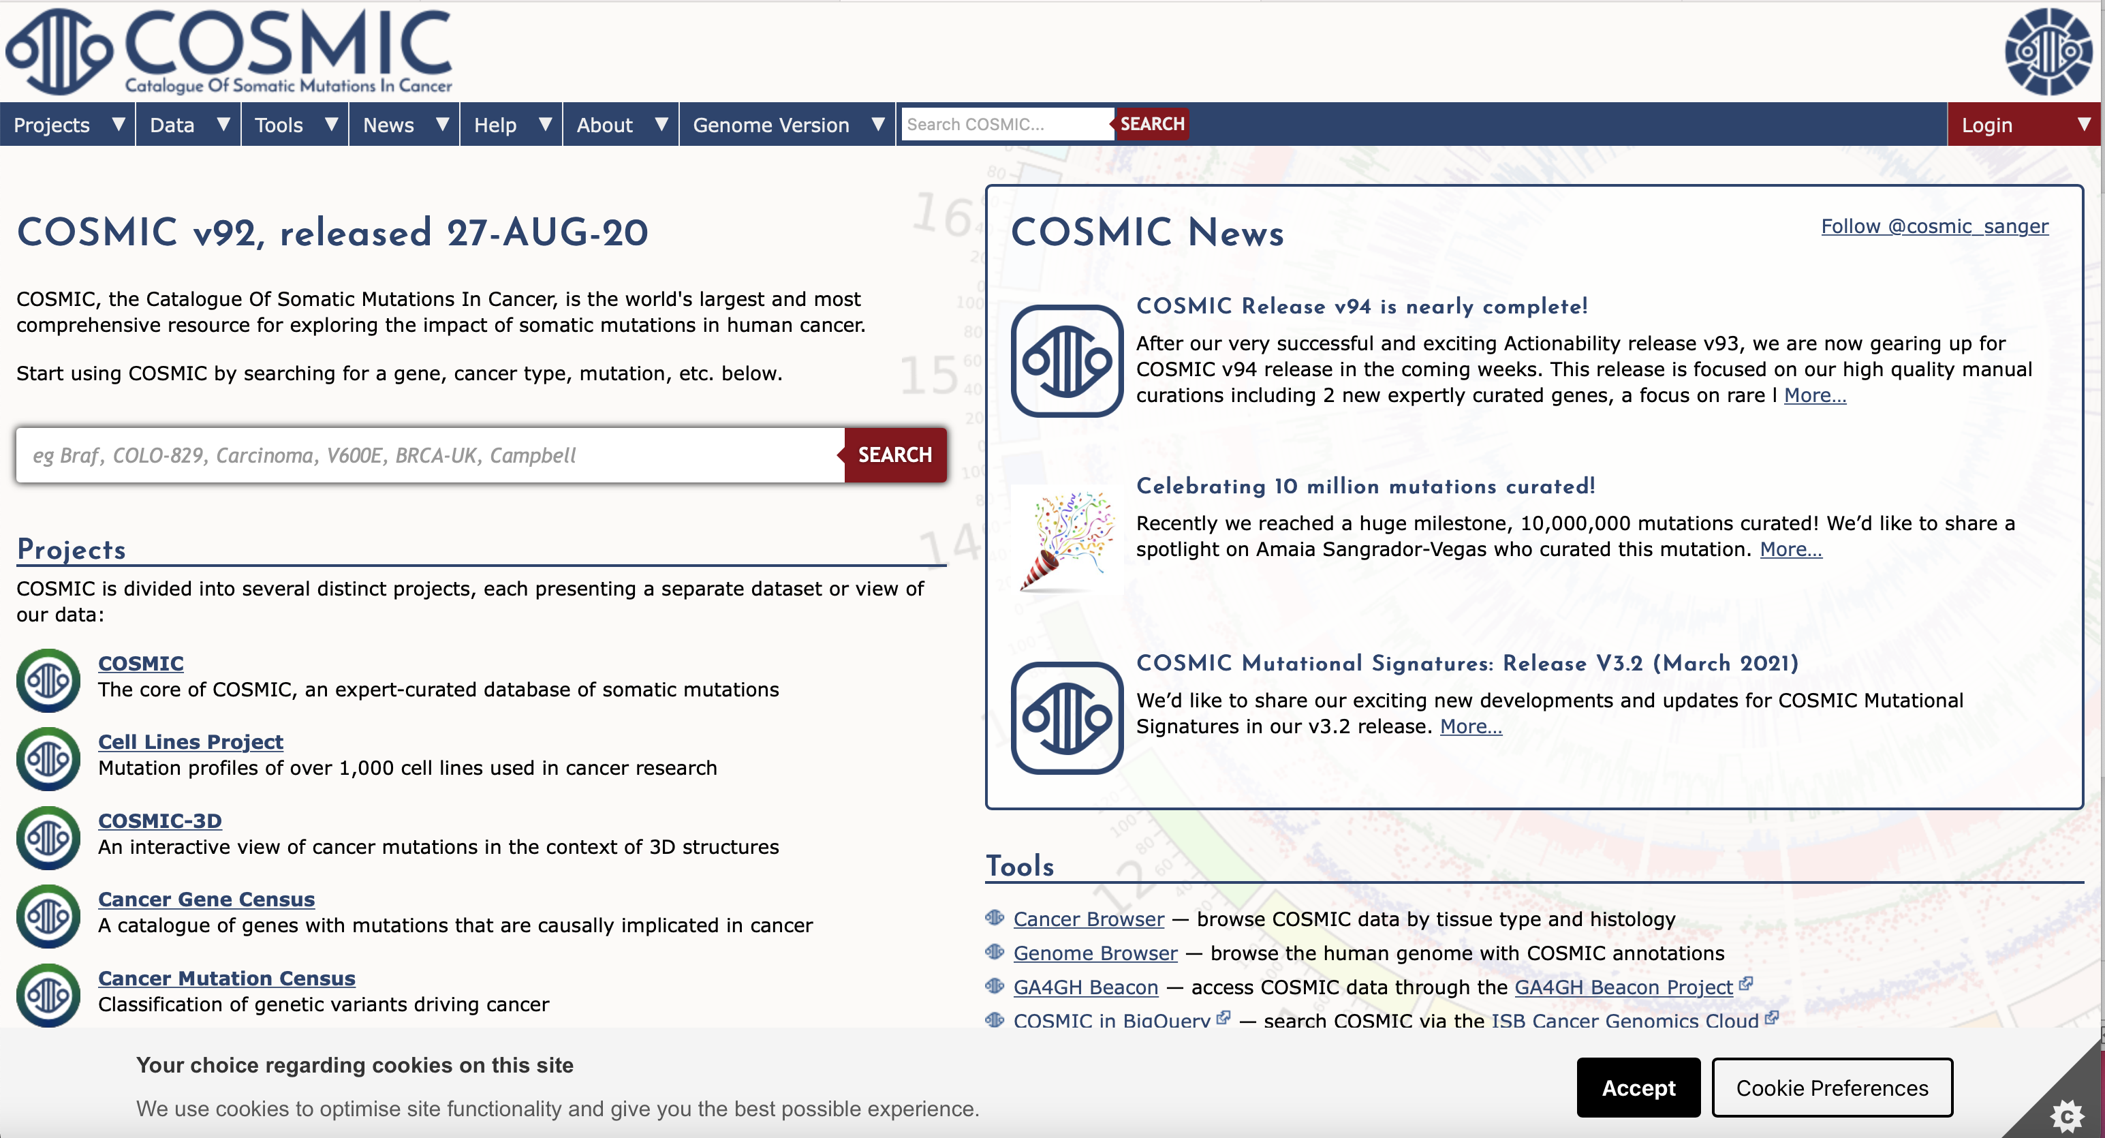
Notes:
Projects: COSMIC, Cell Lines Project, COSMIC-3D, Cancer Gene Census, Cancer Mutation Census, Actionability
Data: Downloads, Gene Curation, Gene Fusion Curation, Genome Screens, Drug Resistance, Mutational Signatures, Actionability
Tools: Cancer Browser, Genome Browser, CONAN, GA4GH Beacon
News:
Help: Contact us, Documentation, FAQ, Classification, Licensing, Data Submission, Genome Annotation, Variatnt Updates
About:
Genome Version:
*Mutation Actionability in Precision Oncology*: The aim of COSMIC Mutation Actionability in Precision Oncology product (Actionability) is to indicate the availability of drugs that target mutations in cancer and track the progress of clinical studies towards making new drugs available.
https://cancer.sanger.ac.uk/cosmic/gene/analysis?ln=EGFR

Slide 8
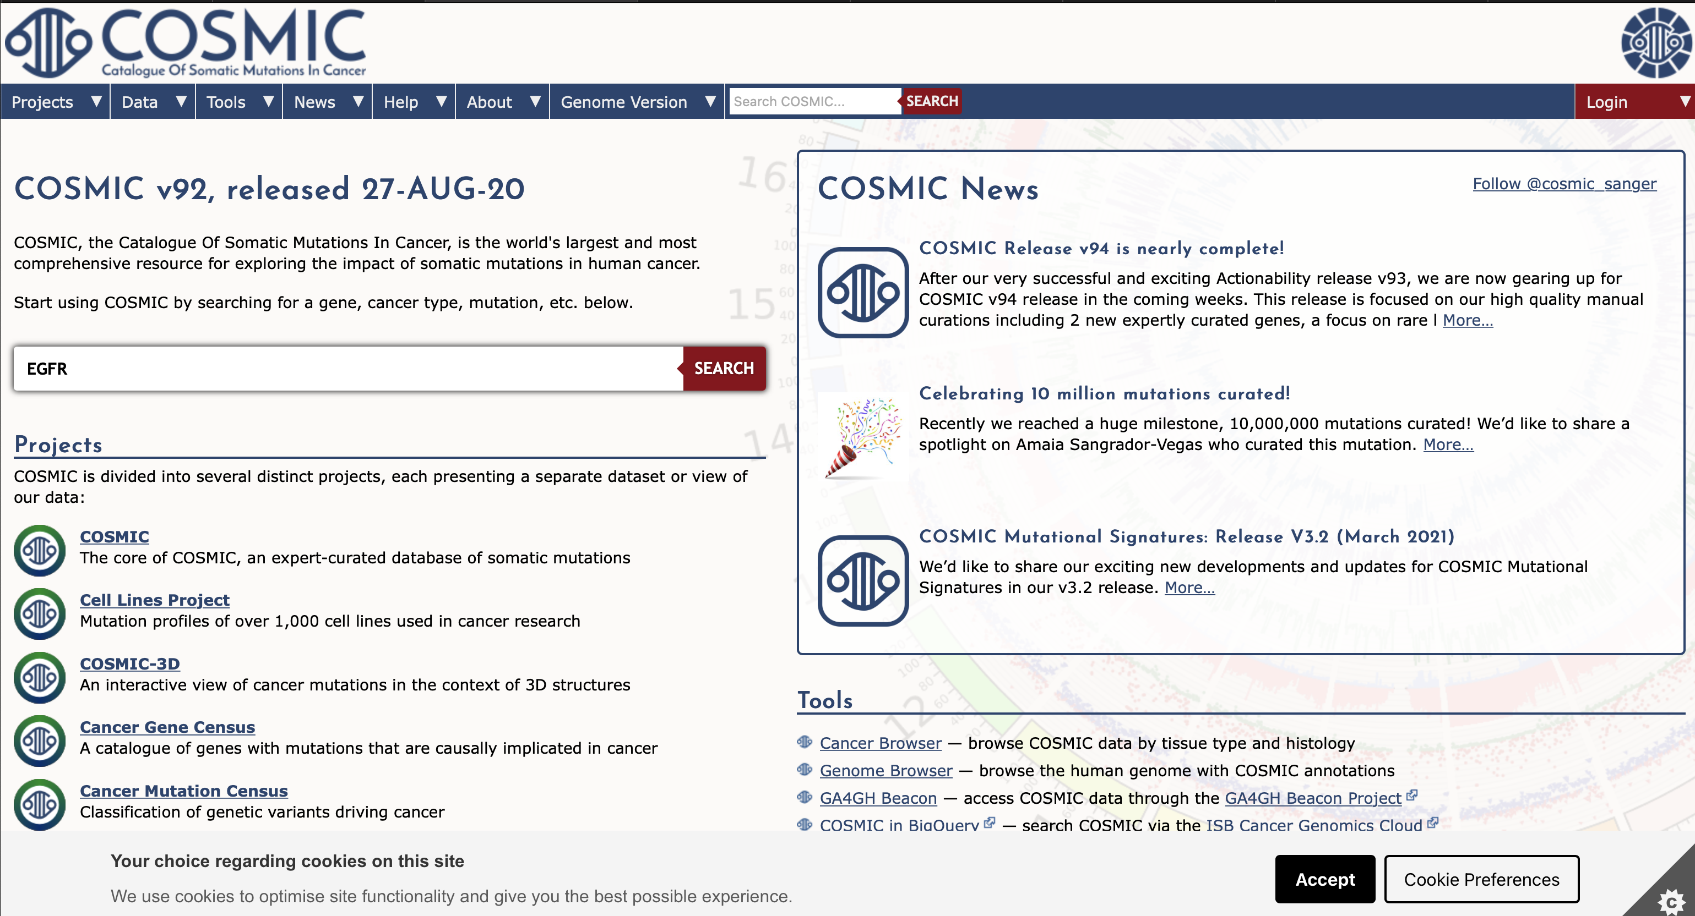
INPUT

Slide 9
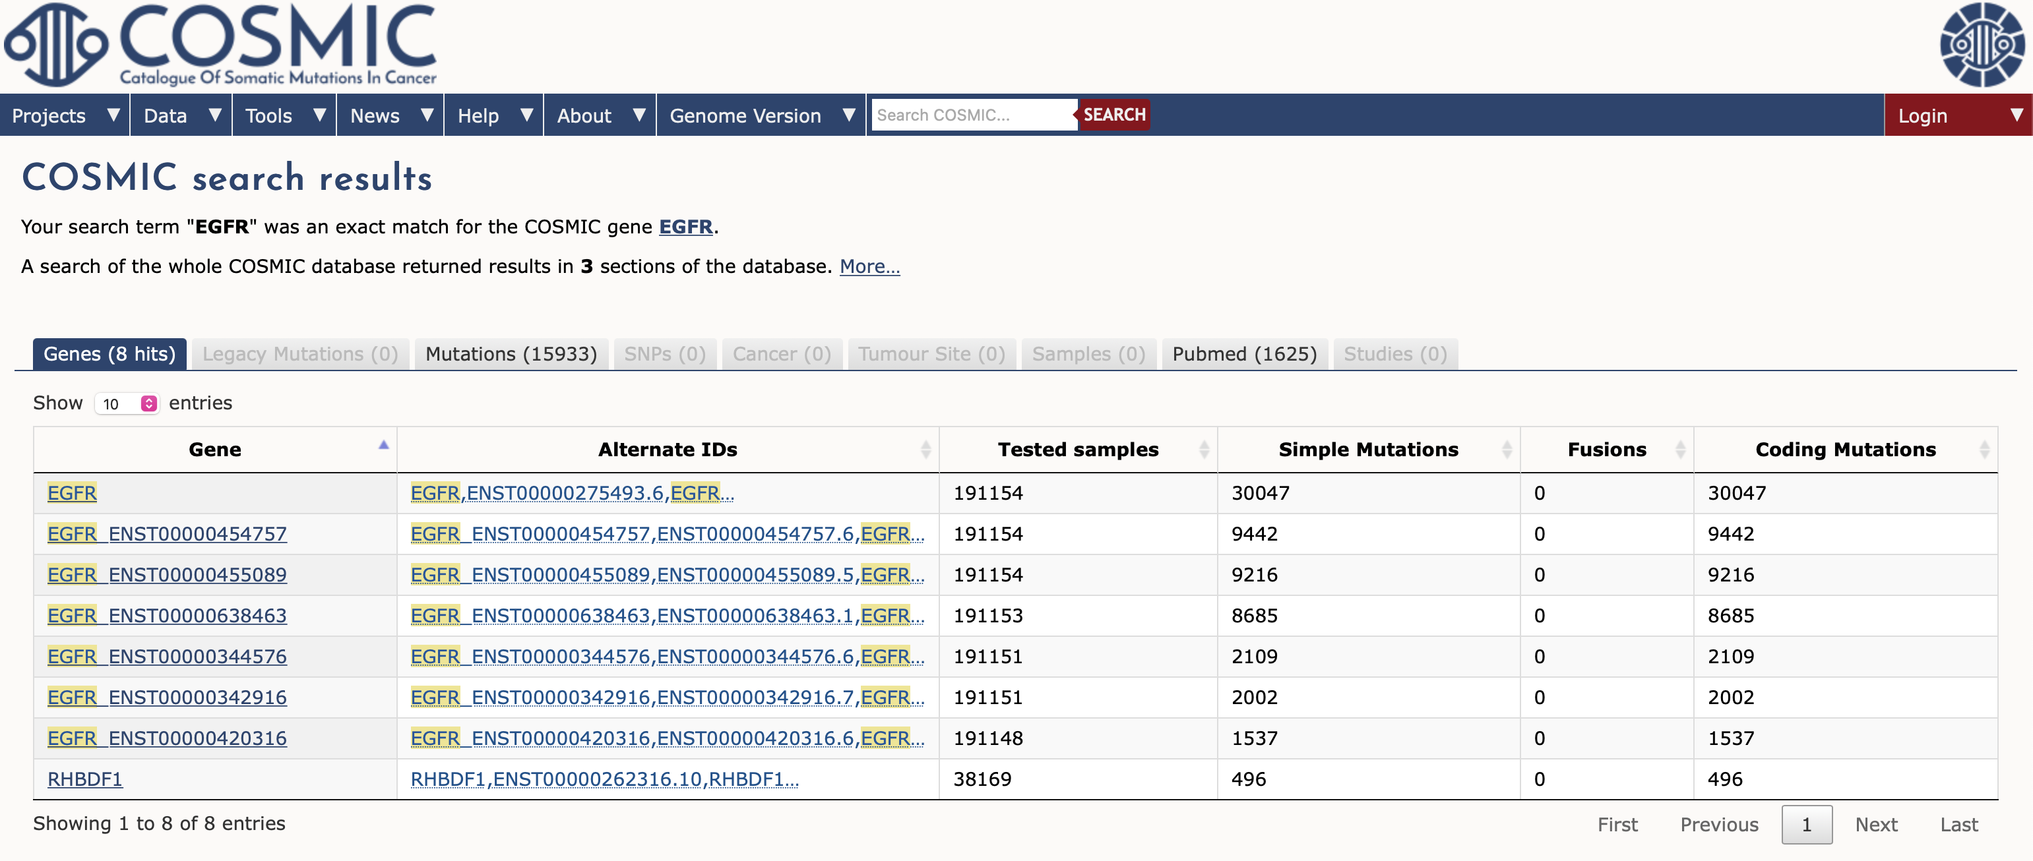
Search Results

Slide 10
EGFR Gene
Gene view
Overview
External links
Drug resistance
Tissue distribution
Genome browser
Mutation distribution
Variations
References

Slide 11
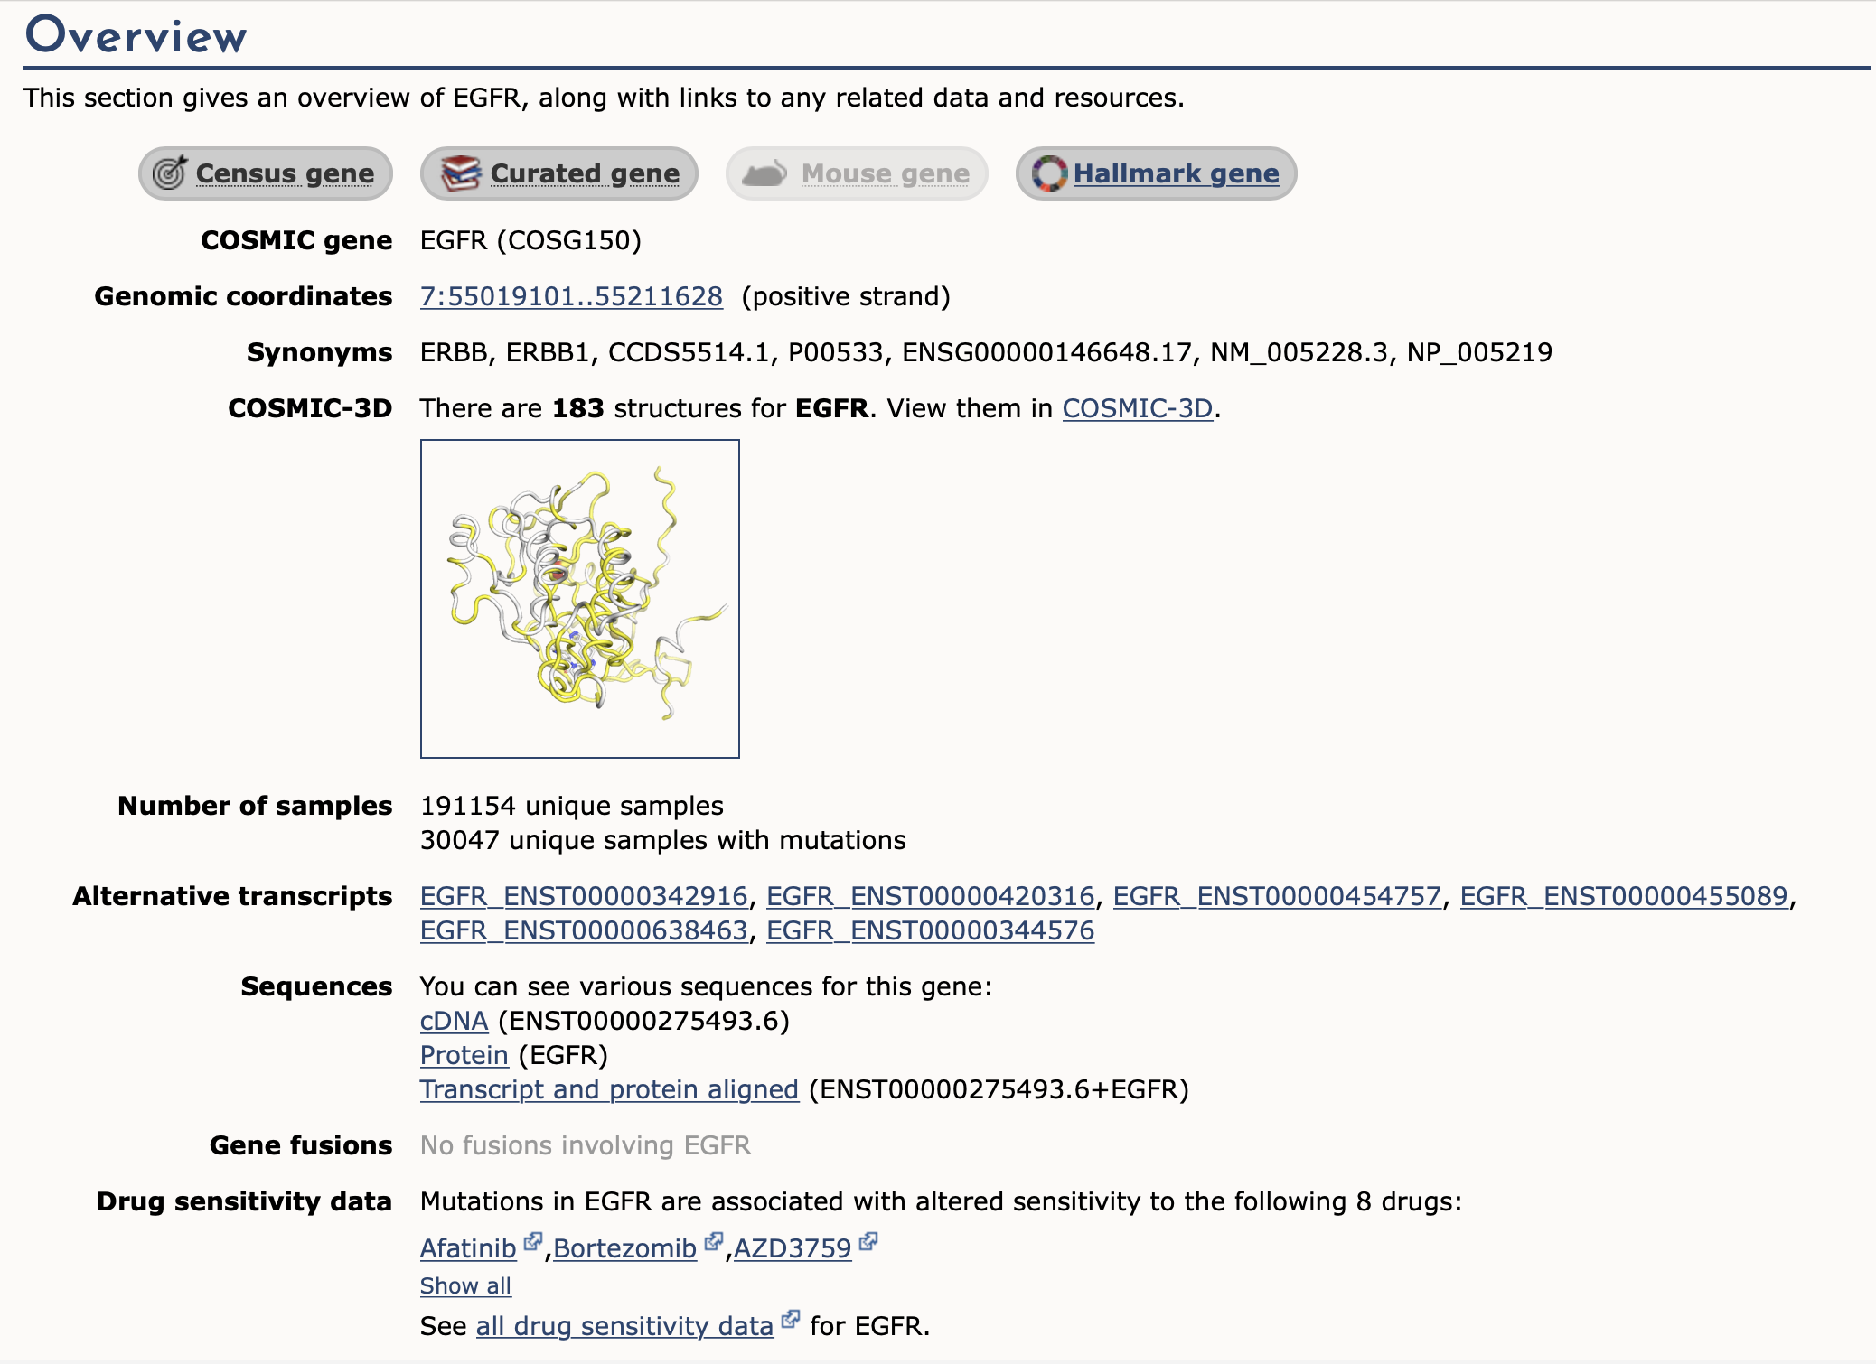
Overview “Tab”
Notes:
Cosmic 3D is a new tool linking the detailed sequence-level mutation data in COSMIC with rich protein structure information from the protein data bank.

Slide 12
https://cancer.sanger.ac.uk/cosmic/gene/analysis?ln=EGFR
Notes:
https://cancer.sanger.ac.uk/cosmic/gene/analysis?ln=EGFR
The gene view histogram is a graphical view of mutations across EGFR. These mutations are displayed at the amino acid level across the full length of the gene by default.

Slide 13
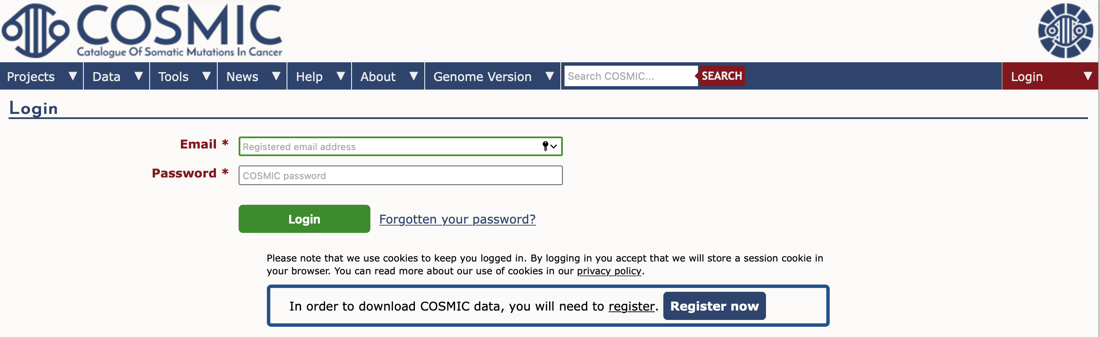
Downloads
Can download full COSMIC files as
.tar
.csv
.tsv
Downloading full files requires you to register and create an account.
Can download from command line on mac, windows, and Linux operating systems (with an account).
Notes:
TAR file format is used to store multiple files in one single file.

Slide 14
Pros & Cons
Pros
Free access for all users
Updated 3-4 times a year (ensures up to date information)
Contains easily accessible links to published references.
Cons
Need to register with an account in order to download files.
There is such a vast amount of information that you need to take a focused approach in order to be efficient on the site.

Slide 15
References
John G Tate, Sally Bamford, Harry C Jubb, Zbyslaw Sondka, David M Beare, Nidhi Bindal, Harry Boutselakis, Charlotte G Cole, Celestino Creatore, Elisabeth Dawson, Peter Fish, Bhavana Harsha, Charlie Hathaway, Steve C Jupe, Chai Yin Kok, Kate Noble, Laura Ponting, Christopher C Ramshaw, Claire E Rye, Helen E Speedy, Ray Stefancsik, Sam L Thompson, Shicai Wang, Sari Ward, Peter J Campbell, Simon A Forbes, COSMIC: the Catalogue Of Somatic Mutations In Cancer, Nucleic Acids Research, Volume 47, Issue D1, 08 January 2019, Pages D941–D947, https://doi.org/10.1093/nar/gky1015
Bamford, S., Dawson, E., Forbes, S. et al. The COSMIC (Catalogue of Somatic Mutations in Cancer) database and website. Br J Cancer 91, 355–358 (2004). https://doi.org/10.1038/sj.bjc.6601894
https://www.oracle.com/database/what-is-a-relational-database/
https://cancer.sanger.ac.uk/cosmic

Slide 16
Thank you for listening!

